Slide 1
Course Name : Data Structures & Algorithms
Bharat Deshpande
Computer Science & Information Systems

Slide 2
Binary Search Trees
A Binary Search Tree (BST) is a binary tree with the following properties:
The key of a node is always greater than the keys of the nodes in its left subtree
The key of a node is always smaller than the keys of the nodes in its right subtree

Slide 3
Binary Search Trees: Examples
root
root
14
C
root
10
16
A
D
8
11
15
18
14
10
16
8
11
15

Slide 4
Building a BST
Build a BST from a sequence of nodes read one a time
Example: Inserting C A B L M (in this order!)
1) Insert C
2) Insert A
C
C
A

Slide 5
Building a BST
3) Insert B
C
5) Insert M
A
B
C
A
L
4) Insert L
C
B
M
A
L
B

Slide 6
Building a BST
Is there a unique BST for letters A B C L M ?
NO! Different input sequences result in different trees
Inserting: A B C L M
Inserting: C A B L M
A
B
C
C
A
L
L
M
B
M

Slide 7
Example Binary Searches
Find ( 2 )
10
5
10 > 2, left
5 > 2, left
2 = 2, found
5 > 2, left
2 = 2, found
5
30
2
45
2
25
45
30
10
25

Slide 8
Recursive Search of Binary Tree
Node Find( Node n, Value key) {
if (n == null) // Not found
return( n );
else if (n.data == key) // Found it
return( n );
else if (n.data > key) // In left subtree
return Find( n.left );
else // In right subtree
return Find( n.right );
}

Slide 9
Complexity of Search
Running time of searching in a BST is proportional to the height of the tree.
If n is the number of nodes in a BST, then
Best Case – O(logn)
Worst Case – O(n)

Slide 10
Binary Search Tree - Insertion
Insert Algorithm
If value we want to insert < key of current node, we have to go to the left subtree
Otherwise we have to go to the right subtree
If the current node is empty (not existing) create a node with the value we are inserting and place it here.

Slide 11
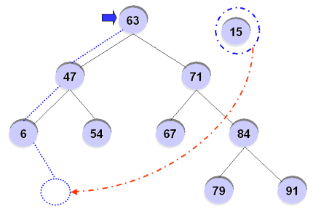
Insertion - Example
For example, inserting ’15’ into the BST?

Slide 12
Binary Search Tree - Deletion
How do we delete a node form BST?
Similar to the insert function, after deletion of a node, the property of the BST must be maintained.

Slide 13
Binary Search Tree - Deletion
There are 3 possible cases
Case1 : Node to be deleted has no children
→ We just delete the node.
Case2 : Node to be deleted has only one child
→ Replace the node with its child and make the parent of the
deleted node to be a parent of the child of the deleted node
Case3 : Node to be deleted has two children

Slide 14
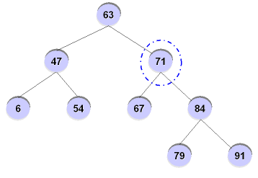
Binary Search Tree - Deletion
Node to be deleted has two children

Slide 15
Binary Search Tree - Deletion
Node to be deleted has two children
Steps:
Find minimum value of right subtree
Delete minimum node of right subtree but keep its value
Replace the value of the node to be deleted by the minimum value whose node was deleted earlier.

Slide 16
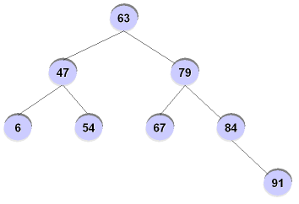
Binary Search Tree - Deletion

